Slide 1

InLoVE
Indoor Localization using Voice Enabled Systems
Team Members
Corey Doss
Pavan Kumar Kota
Sindhusha Tiyyagura
Sravan Kumar Pagadala

Slide 2

Motivation
Location finding by using wireless technology is one of the emerging and important technologies.
GPS can be utilized for outdoor areas but it cannot be used for tracking the user inside the building.
The main motivation is to implement the system which can locate and track the user inside the building

Slide 3
Problems and Solution
Current problems
Our Solutions
Guide people inside a shopping mall
Museum tours : Your phone can be your virtual guide that'll give you contextual information based on your location.
Warehouses : Improved automation capabilities.
Airport, Hospitals, Hotels : Benefits are similar to above applications.
Guidance to visually impaired : With audible & sensory feedback
Using Magnetic Fields:
Advantage : Finding location using Smart Phone (Inbuilt)
Disadvantage : Magnetic Field Varies because of Moving Object
Using Signal Strength:
Advantages :
*Accurate location than Magnetic Fields
*Low Cost

Slide 4

proposal
Indoor Localization using Voice Enabled systems
Achieves more accurate location for indoors using Internet of Things and using smart devices.

Slide 5
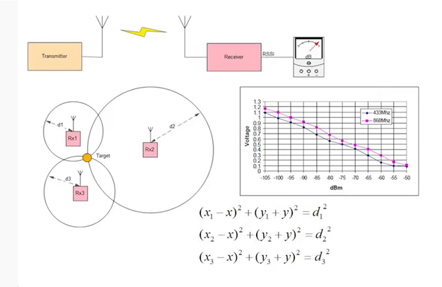
RSSI triangulation
Received signal strength indication (RSSI) is a measurement of the power level received by sensor.
Units: dBm
Triangulation is the process of determining the location of a point from known points.

Slide 6
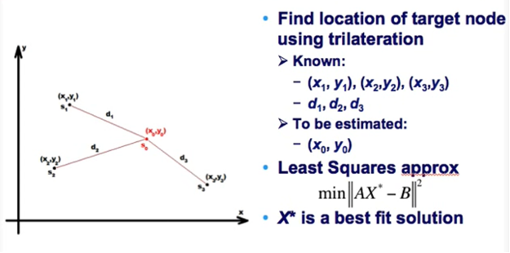
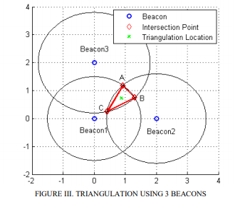
RSSI triangulation
Received signal strength indication (RSSI) is a measurement of the power level received by sensor.
Units: dBm
Triangulation is the process of determining the location of a point from known points.

Slide 7
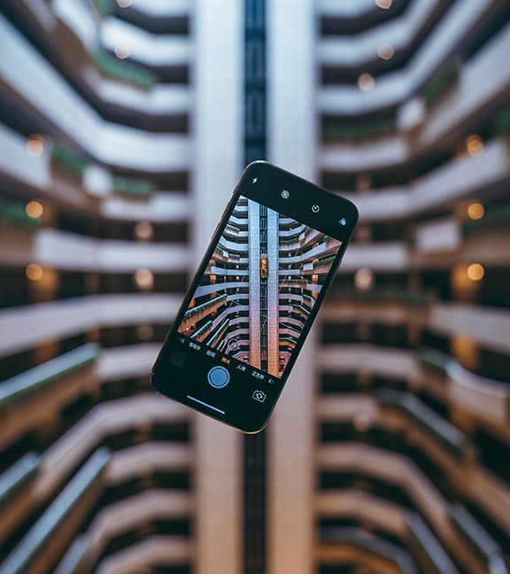
Application Uses
Indoor navigation
Controlling robots or forklifts in a warehouse
Rescue operation

Slide 8


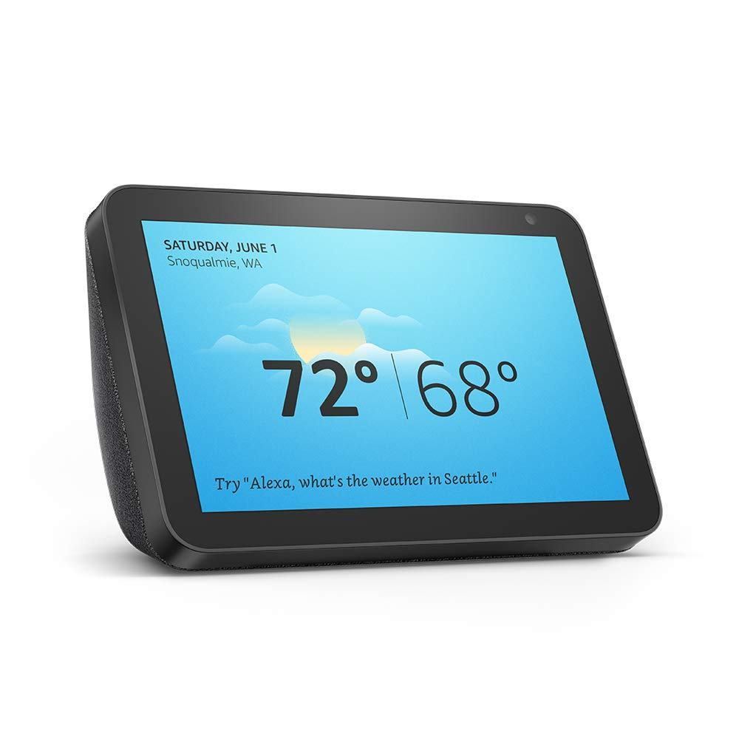

Technologies
ALEXA
ESP8266

Slide 9
Phases
01
User gives voice request to Alexa
User Request
Estimate Distance
Sending Beacons and Measuring Signal Strength.
02
03
Locating accurate location using triangulation
Estimate Position
Inform Alexa
Sending Location Information to Alexa
04
05
Display bird view on user device
Result

Slide 10
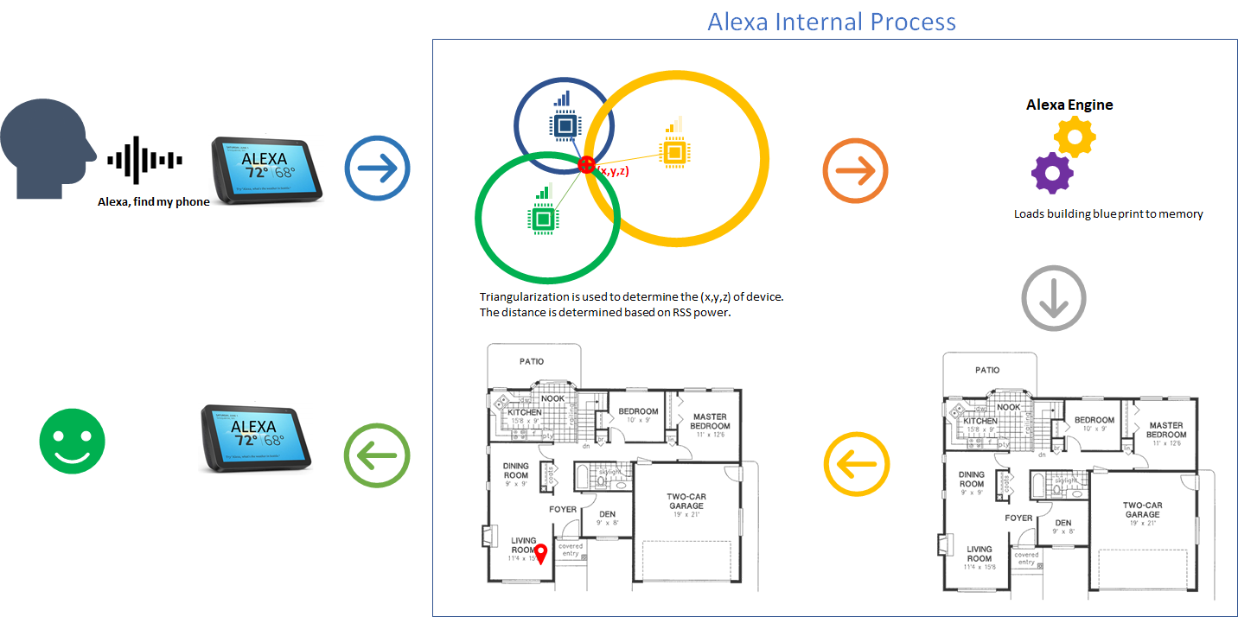
Block Diagram

Slide 11
Anticipated problems
Non-stationary objects such as doors, furniture, and people can pose an even greater problem, as they can affect the signal strength in dynamic, unpredictable ways.
Low Accuracy

Slide 12
THANK YOU
With Love from InLoVE team

